Slide 1
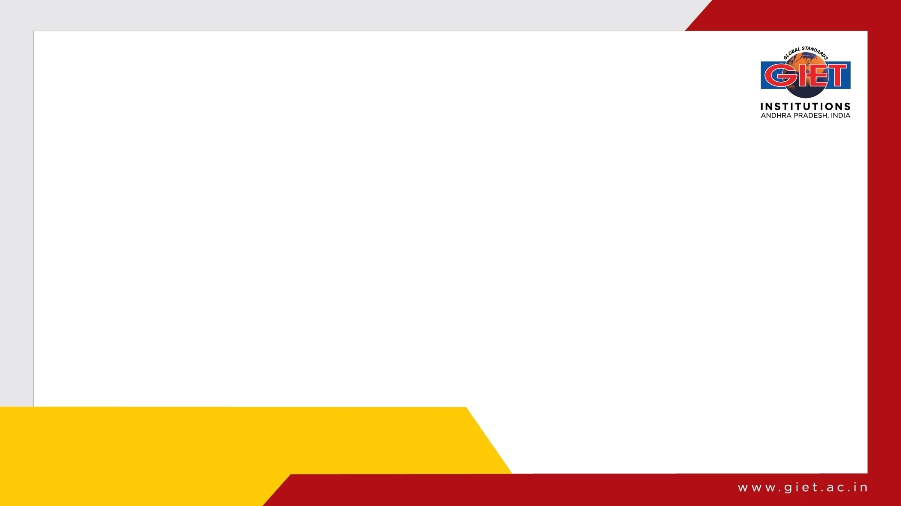
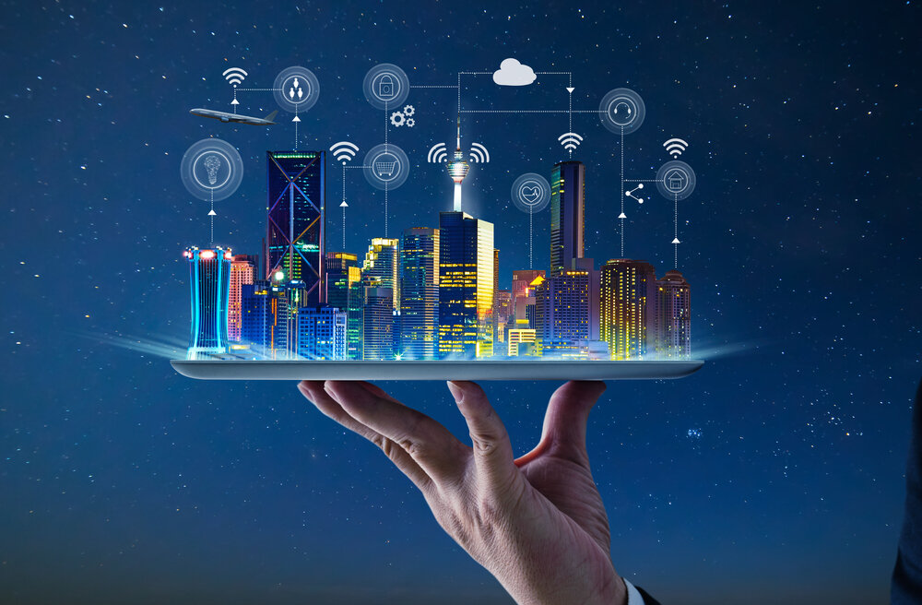
Internet of Things
(IoT)

Slide 2
Internet of Things(IoT) - Syllabus
UNIT – 4 :- DATA ANALYTICS AND SERVICES
Structured Vs Unstructured Data and Data in Motion Vs Data in Rest, Role of Machine Learning — No SQL Databases, Hadoop Ecosystem, Apache Kafka, Apache Spark, Edge Streaming Analytics, Xively Cloud for IoT, Python Web Application.
Lecture Details:
Fundamentals Of IoT
Branch: CSM
Semester: III-II

Slide 3
Cont..
INTRODUCTION
This In the world of IoT, the creation of massive amounts of data from sensors is common and one of the biggest challenges—not only from a transport perspective but also from a data management standpoint.
A great example of the deluge of data that can be generated by IoT is found in the commercial aviation industry and the sensors that are deployed throughout an aircraft

Slide 4
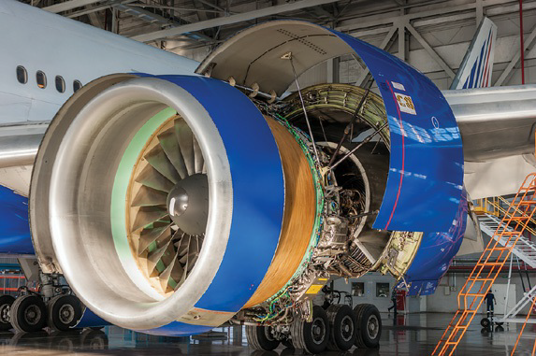
Cont..
INTRODUCTION
Commercial Jet Engine

Slide 5
Cont..
INTRODUCTION
Example:
This Modern jet engines, similar to the one shown in Figure may be equipped with around 5000 sensors.
Therefore, a twin engine commercial aircraft with these engines operating on average 8 hours a day will generate over 500 TB of data daily, and this is just the data from the engines!
Aircraft today have thousands of other sensors connected to the airframe and other systems.
In fact, a single wing of a modern jumbo jet is equipped with 10,000 sensors. Petabyte (PB) of data per day per commercial airplane.
Across the world, there are approximately 100,000 commercial flights per day. The amount of IoT data coming just from the commercial airline business is overwhelming

Slide 6
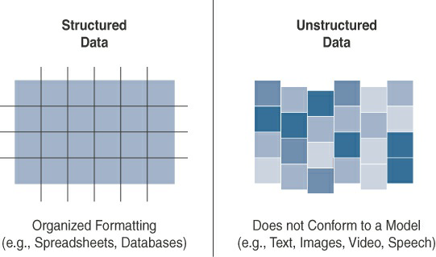
Cont..
STRUCTURED VERSUS UNSTRUCTURED DATA

Slide 7
Cont..
STRUCTURED VERSUS UNSTRUCTURED DATA
Structured data means that the data follows a model or schema that defines how the data is represented or organized, meaning it fits well with a traditional relational database management system (RDBMS).
Structured data can be found in most computing systems and includes everything from banking transaction and invoices to computer log files and router configurations.
IoT sensor data often uses structured values, such as temperature, pressure, humidity, and so on, which are all sent in a known format.
Structured data is easily formatted, stored, queried, and processed; for these reasons, it has been the core type of data used for making business decisions. Because of the highly organizational format of structured data, a wide array of data analytics tools are readily available for processing this type of data.

Slide 8
Cont..
STRUCTURED VERSUS UNSTRUCTURED DATA
Unstructured data lacks a logical schema for understanding and decoding the data through traditional programming means. Examples of this data type include text, speech, images, and video.
Data analytics methods that can be applied to unstructured data, such as cognitive computing and machine learning.
With machine learning applications, such as natural language processing (NLP), you can decode speech.
With image/facial recognition applications, you can extract critical information from still images and video.

Slide 9
Cont..
STRUCTURED VERSUS UNSTRUCTURED DATA
Smart objects in IoT networks generate both structured and unstructured data.
Structured data is more easily managed and processed due to its well-defined organization.
On the other hand, unstructured data can be harder to deal with and typically requires very different analytics tools for processing the data.
Being familiar with both of these data classifications is important because knowing which data classification you are working with makes integrating with the appropriate data analytics solution much easier.

Slide 10
Cont..
DATA IN MOTION VERSUS DATA AT REST
In most networks, data in IoT networks is either in transit (“data in motion”) or being held or stored (“data at rest”).
Examples of data in motion include traditional client/server exchanges, such as web browsing and file transfers, and email.
Data saved to a hard drive, storage array, or USB drive is data at rest.
From an IoT perspective, the data from smart objects is considered data in motion as it passes through the network enroute to its final destination. This is often processed at the edge, using fog computing.

Slide 11
Cont..
DATA IN MOTION VERSUS DATA AT REST
When data is processed at the edge, it may be filtered and deleted or forwarded on for further processing and possible storage at a fog node or in the data center. Data does not come to rest at the edge.
When data arrives at the data center, it is possible to process it in real-time, just like at the edge, while it is still in motion.
Tools with this sort of capability, such as Spark, Storm, and Flink, are relatively nascent compared to the tools for analyzing stored data.

Slide 12
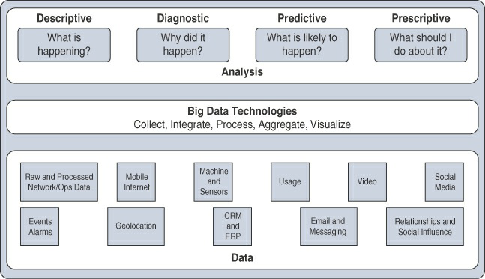
Cont..
IOT DATA ANALYTICS OVERVIEW

Slide 13
Cont..
IOT DATA ANALYTICS OVERVIEW
Descriptive:
Descriptive data analysis tells you what is happening, either now or in the past.
For example, a thermometer in a truck engine reports temperature values every second.
From a descriptive analysis perspective, you can pull this data at any moment to gain insight into the current operating condition of the truck engine.
If the temperature value is too high, then there may be a cooling problem or the engine may be experiencing too much load.

Slide 14
Cont..
IOT DATA ANALYTICS OVERVIEW
Diagnostic:
When you are interested in the “why,” diagnostic data analysis can provide the answer.
Continuing with the example of the temperature sensor in the truck engine, you might wonder why the truck engine failed.
Diagnostic analysis might show that the temperature of the engine was too high, and the engine overheated.
Applying diagnostic analysis across the data generated by a wide range of smart objects can provide a clear picture of why a problem or an event occurred.

Slide 15
Cont..
IOT DATA ANALYTICS OVERVIEW
Predictive:
Predictive analysis aims to foretell problems or issues before they occur.
For example, with historical values of temperatures for the truck engine, predictive analysis could provide an estimate on the remaining life of certain components in the engine.
These components could then be proactively replaced before failure occurs.
Or perhaps if temperature values of the truck engine start to rise slowly over time, this could indicate the need for an oil change or some other sort of engine cooling maintenance.

Slide 16
Cont..
IOT DATA ANALYTICS OVERVIEW
Prescriptive:
Prescriptive analysis goes a step beyond predictive and recommends solutions for upcoming problems.
A prescriptive analysis of the temperature data from a truck engine might calculate various alternatives to cost-effectively maintain our truck.
These calculations could range from the cost necessary for more frequent oil changes Cooling maintenance to installing new cooling equipment on the engine Upgrading to a lease on a model with a more powerful engine.
Prescriptive analysis looks at a variety of factors and makes the appropriate recommendation.

Slide 17
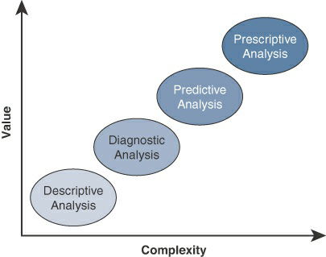
Cont..
IOT DATA ANALYTICS OVERVIEW
Prescriptive:
Prescriptive analysis goes a step beyond predictive and recommends solutions for upcoming problems.

Slide 18
Cont..
IOT DATA ANALYTICS CHALLENGES
Scaling problems:
Due to the large number of smart objects in most IoT networks that continually send data, relational databases can grow incredibly large very quickly. This can result in performance issues that can be costly to resolve, often requiring more hardware and architecture changes.
Volatility of data:
With relational databases, it is critical that the schema be designed correctly from the beginning. Changing it later can slow or stop the database from operating. Due to the lack of flexibility, revisions to the schema must be kept at a minimum.
IoT data, however, is volatile in the sense that the data model is likely to change and evolve over time. A dynamic schema is often required so that data model changes can be made daily or even hourly.

Slide 19
Cont..
MACHINE LEARNING
One of the core subjects in IoT is how to makes sense of the data that is generated. Because much of this data can appear incomprehensible to the naked eye, specialized tools and algorithms are needed to find the data relationships that will lead to new business insights.
This brings us to the subject of machine learning (ML).
ML is indeed central to IoT. Data collected by smart objects needs to be analyzed, and intelligent actions need to be taken based on these analyses.
Performing this kind of operation manually is almost impossible (or very, very slow and inefficient).
Machines are needed to process information fast and react instantly when thresholds are met.

Slide 20
Cont..
MACHINE LEARNING
One of Machine learning is, in fact, part of a larger set of technologies commonly grouped under the term artificial intelligence (AI).
This term used to make science fiction amateurs dream of biped robots and conscious machines, or of a Matrix-like world where machines would enslave humankind.
AI includes any technology that allows a computing system to mimic human intelligence using any technique, from very advanced logic to basic “if-then-else” decision loops.

Slide 21
Cont..
MACHINE LEARNING
A simple example is an app that can help you find your parked car.
Simple static rule set
In more complex cases, static rules cannot be simply inserted into the program because they require parameters that can change or that are imperfectly understood.
A typical example is a dictation program that runs on a computer.
The program is configured to recognize the audio pattern of each word in a dictionary, but it does not know your voice’s accent, tone, speed, and so on.

Slide 22
Cont..
MACHINE LEARNING
You need to record a set of predetermined sentences to help the tool match well-known words to the sounds you make when you say the words.
This process is called machine learning. ML is concerned with any process where the computer needs to receive a set of data that is processed to help perform a task with more efficiency.

Slide 23
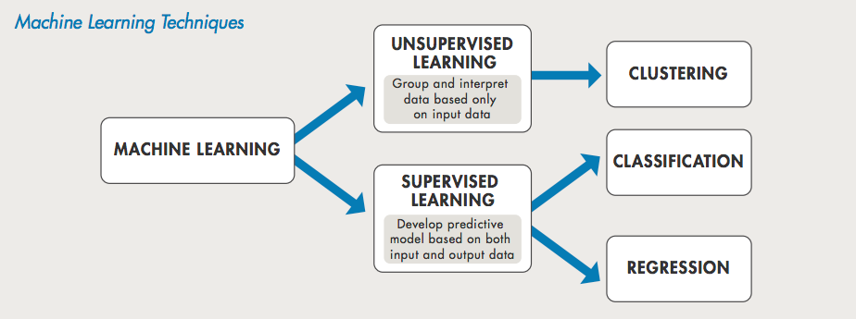
Cont..
MACHINE LEARNING

Slide 24
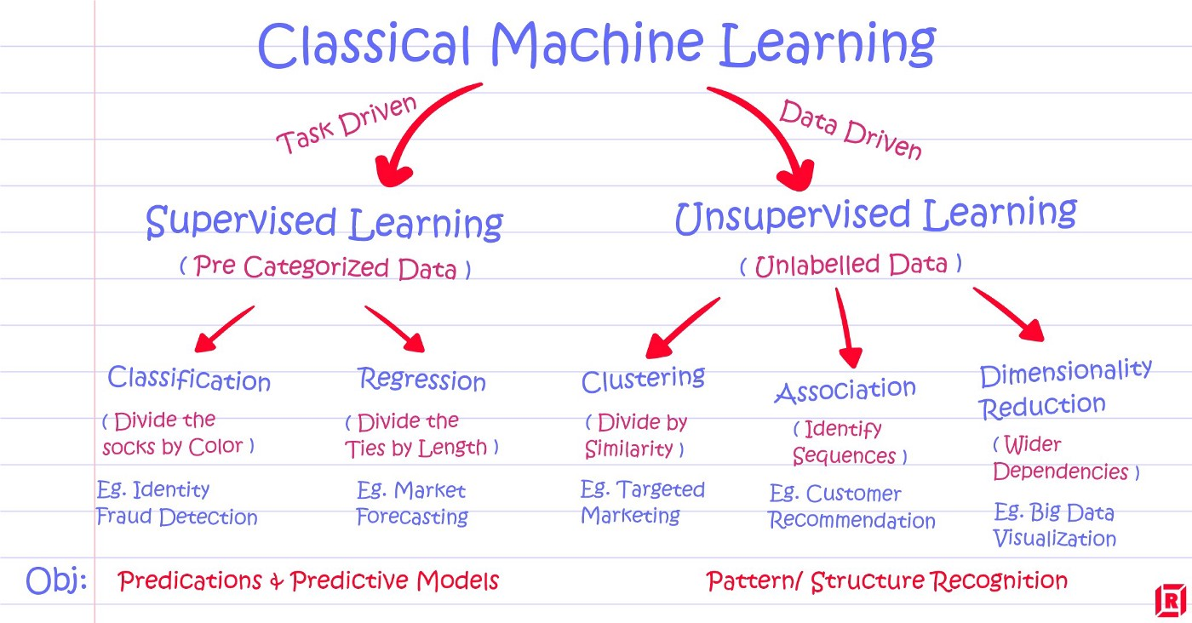
Cont..
MACHINE LEARNING

Slide 25
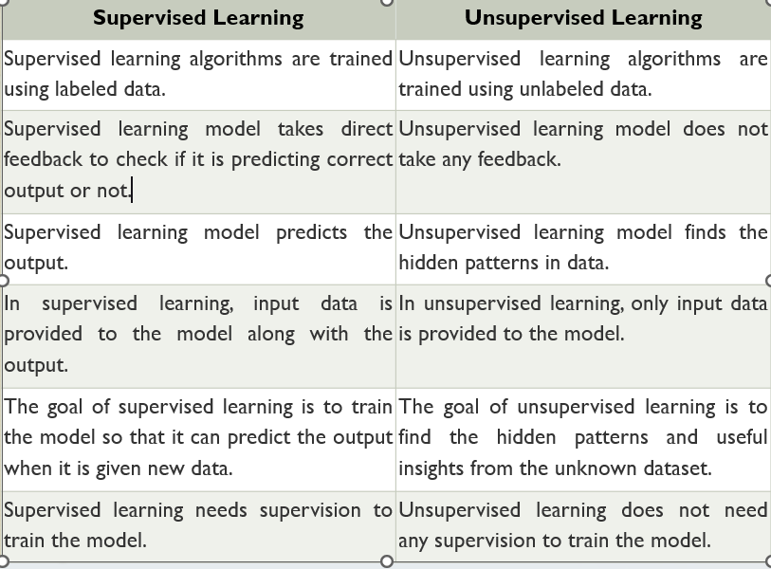
Cont..
MACHINE LEARNING

Slide 26
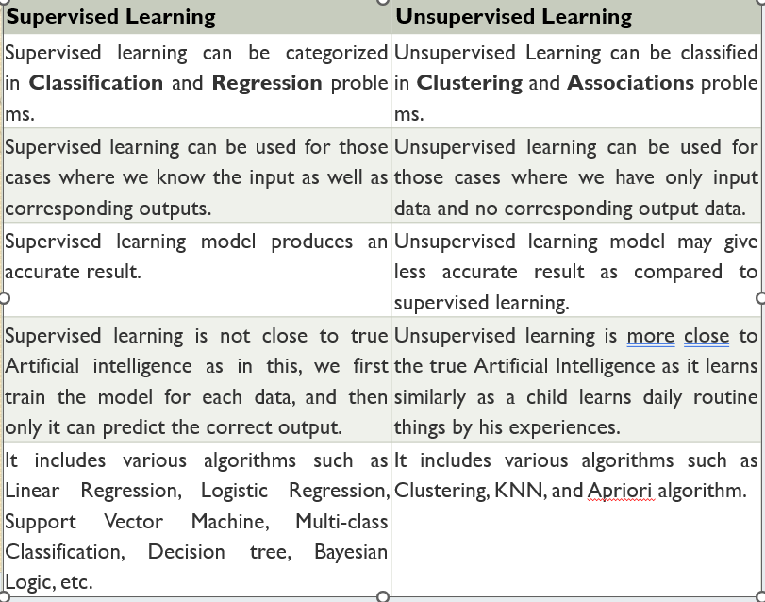
Cont..
MACHINE LEARNING

Slide 27
Cont..
MACHINE LEARNING
Neural networks
ML methods that mimic the way the human brain works.
When you look at a human figure, multiple zones of your brain are activated to recognize colors, movements, facial expressions, and so on.
Your brain combines these elements to conclude that the shape you are seeing is human. Neural networks mimic the same logic

Slide 28
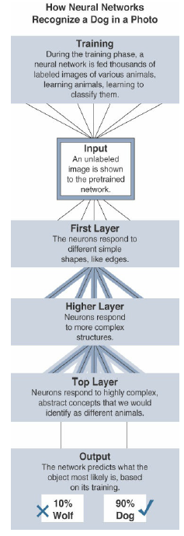
Cont..
MACHINE LEARNING

Slide 29
Cont..
INTRODUCTION TO NOSQL DATABASES
A database Management System provides the mechanism to store and retrieve the data.
There are different kinds of database management systems:
1.RDBMS (Relational Database Management Systems)
2.OLAP (Online Analytical Processing)
3.NoSQL (Not only SQL)

Slide 30
Cont..
INTRODUCTION TO NOSQL DATABASES
What is a NoSQL database?
NoSQL databases are different relational databases like MQSQL.
In relational database you need to create the table, define schema, set the data types of fields etc., before you can actually insert the data.
In NoSQL you don’t have to worry about that, you can insert, update on the fly.

Slide 31
Cont..
INTRODUCTION TO NOSQL DATABASES
Limitations of Relational databases:
1. In relational database we need to define structure and schema of data first and then only we can process the data.
2. Relational database systems provides consistency and integrity of data by enforcing ACID properties (Atomicity, Consistency, Isolation and Durability ). There are some scenarios where this is useful like banking system. However in most of the other cases these properties are significant performance overhead and can make your database response very slow.
3. Most of the applications store their data in JSON (Javascript Object Notation) format and RDBMS don’t provide you a better way of performing operations such as create, insert, update, delete etc., on this data. On the other hand NoSQL store their data in JSON format, which is compatible with most of the today’s world application.

Slide 32
Cont..
INTRODUCTION TO NOSQL DATABASES
What are the advantages of NoSQL:
High scalability.
High Avalability.
Here are the types of NoSQL databases and the name of the databases system that falls in that category. MongoDB falls in the category of NoSQL document based database.
Key Value Store: Memcached, Redis, Coherance
Tabular: Hbase, Big Table, Accumulo
Document based: MONGODB, CouchDB, Cloudant

Slide 33
Cont..
INTRODUCTION TO NOSQL DATABASES
When to go for NoSQL over relational database:
When you want to store and retrieve huge amount of data.
The relationship between the data you store is not that important.
The data is not structured and changing over time
Constraints and Joins support is not required at database level
The data is growing continuously and you need to scale the database regular to handle the data.

Slide 34
Cont..
HADOOP OVERVIEW
Apache Hadoop is an open source framework intended to make interaction with big data easier.
Hadoop has made its place in the industries and companies that need to work on large data sets which are sensitive and needs efficient handling.
Hadoop is a framework that enables processing of large data sets which reside in the form of clusters.
Being a framework, Hadoop is made up of several modules that are supported by a large ecosystem of technologies.

Slide 35
Cont..
HADOOP ECOSYSTEM
Hadoop Ecosystem is a platform or a suite which provides various services to solve the big data problems.
It includes Apache projects and various commercial tools and solutions.There are four major elements of Hadoop i.e. HDFS, MapReduce, YARN, and Hadoop Common
Most of the tools or solutions are used to supplement or support these major elements.
All these tools work collectively to provide services such as absorption, analysis, storage and maintenance of data etc.

Slide 36
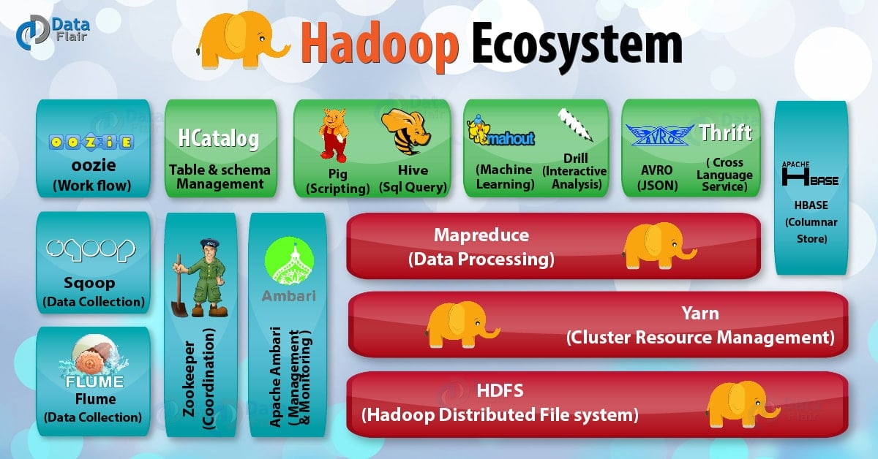
Cont..
HADOOP ECOSYSTEM

Slide 37
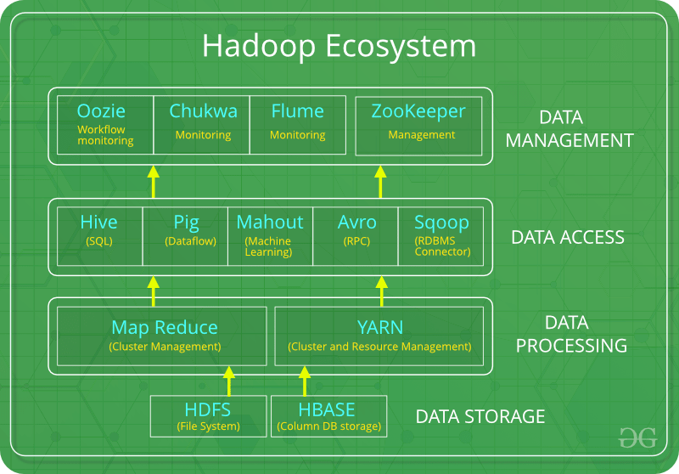
Cont..
HADOOP ECOSYSTEM

Slide 38
Cont..
HADOOP ECOSYSTEM
Following are the components that collectively form a Hadoop Ecosystem
HDFS: Hadoop Distributed File System
YARN : Yet Another Resource Negotiator
MapReduce : Programming based Data Processing
Spark: In-Memory data processing
HIVE, PIG : Query based processing of data services
HBase: NoSQL Database
Mahout, Spark MLLib: Machine Learning algorithm libraries
Solar, Lucene: Searching and Indexing
Zookeeper: Managing cluster
Oozie: Job Scheduling

Slide 39
Cont..
HADOOP ECOSYSTEM
Hadoop Distributed File System:
HDFS is the primary or major component of Hadoop ecosystem and is responsible for storing large data sets of structured or unstructured data across various nodes and thereby maintaining the metadata in the form of log files.
HDFS splits files into blocks and sends them across various nodes in form of large clusters. Also in case of a node failure, the system operates and data transfer takes place between the nodes which are facilitated by HDFS.
It is highly fault-tolerant and is designed to be deployed on low-cost hardware.
It provides high throughput access to application data and is suitable for applications having large datasets.

Slide 40
Cont..
HADOOP ECOSYSTEM
Hadoop Distributed File System:
HDFS consists of two core components i.e.
Name node
Data Node
Name Node is the prime node which contains metadata (data about data) requiring comparatively fewer resources than the data nodes that stores the actual data. These data nodes are commodity hardware in the distributed environment. Undoubtedly, making Hadoop cost effective.
NameNode does not store actual data or dataset. NameNode stores Metadata i.e. number of blocks, their location, on which Rack, which Datanode the data is stored and other details. It consists of files and directories.
HDFS maintains all the coordination between the clusters and hardware, thus working at the heart of the system.

Slide 41
Cont..
HADOOP ECOSYSTEM
Hadoop Distributed File System:
It is also known as Slave.
HDFS Datanode is responsible for storing actual data in HDFS. Datanode performs read and write operation as per the request of the clients.
Replica block of Datanode consists of 2 files on the file system. The first file is for data and second file is for recording the block’s metadata.
HDFS Metadata includes checksums for data. At startup, each Datanode connects to its corresponding Namenode and does handshaking.
Verification of namespace ID and software version of DataNode take place by handshaking. At the time of mismatch found, DataNode goes down automatically.

Slide 42
Cont..
HADOOP ECOSYSTEM
MapReduce:
MapReduce is a parallel programming model for writing distributed applications devised at Google for efficient processing of large amounts of data multi−terabyte data sets−on large clusters thousands of nodes of commodity hardware in a reliable, fault-tolerant manner.
The MapReduce program runs on Hadoop which is an Apache open-source framework
By making the use of distributed and parallel algorithms, MapReduce makes it possible to carry over the processing’s logic and helps to write applications which transform big data sets into a manageable one.

Slide 43
Cont..
HADOOP ECOSYSTEM
MapReduce:
MapReduce makes the use of two functions i.e. Map() and Reduce() whose task is:
Map() performs sorting and filtering of data and thereby organizing them in the form of group. Map generates a key-value pair based result which is later on processed by the Reduce() method.
Reduce(), as the name suggests does the summarization by aggregating the mapped data. In simple, Reduce() takes the output generated by Map() as input and combines those tuples into smaller set of tuples.

Slide 44
Cont..
HADOOP ECOSYSTEM
YARN:
Yet Another Resource Negotiator, as the name implies, YARN is the one who helps to manage the resources across the clusters.
In short, it performs scheduling and resource allocation for the Hadoop System. Consists of three major components i.e.
Resource Manager
Nodes Manager
Application Manager
Resource manager has the privilege of allocating resources for the applications in a system whereas Node managers work on the allocation of resources such as CPU, memory, bandwidth per machine and later on acknowledges the resource manager.
Application manager works as an interface between the resource manager and Node manager and performs negotiations as per the requirement of the two.

Slide 45
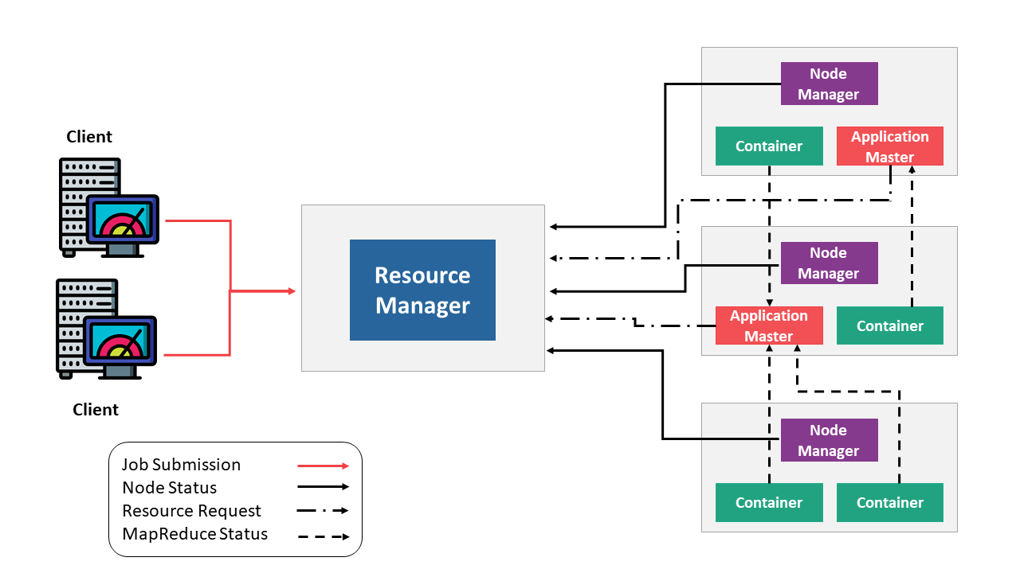
Cont..
HADOOP ECOSYSTEM
YARN Architecture:

Slide 46
Cont..
HADOOP ECOSYSTEM
YARN:
Apache YARN – “ Yet Another Resource Negotiator, “is the resource management layer of Hadoop.
The Yarn was introduced in Hadoop 2.x. Yarn allows different data processing engines like graph processing, interactive processing, stream processing as well as batch processing to run and process data stored in HDFS. Apart from resource management, Yarn also does job Scheduling.

Slide 47
Cont..
HADOOP ECOSYSTEM
HIVE:
HIVE performs reading and writing of large data sets. However, its query language is called as HQL (Hive Query Language).
It is highly scalable as it allows real-time processing and batch processing both. Also, all the SQL data types are supported by Hive thus, making the query processing easier.
Similar to the Query Processing frameworks, HIVE too comes with two components: JDBC (Java Database Connectivity)Drivers and HIVE Command Line.
JDBC, along with ODBC (Open Database Connectivity) drivers work on establishing the data storage permissions and connection whereas HIVE Command line helps in the processing of queries.
Hive do three main functions: data summarization, query, and analysis.

Slide 48
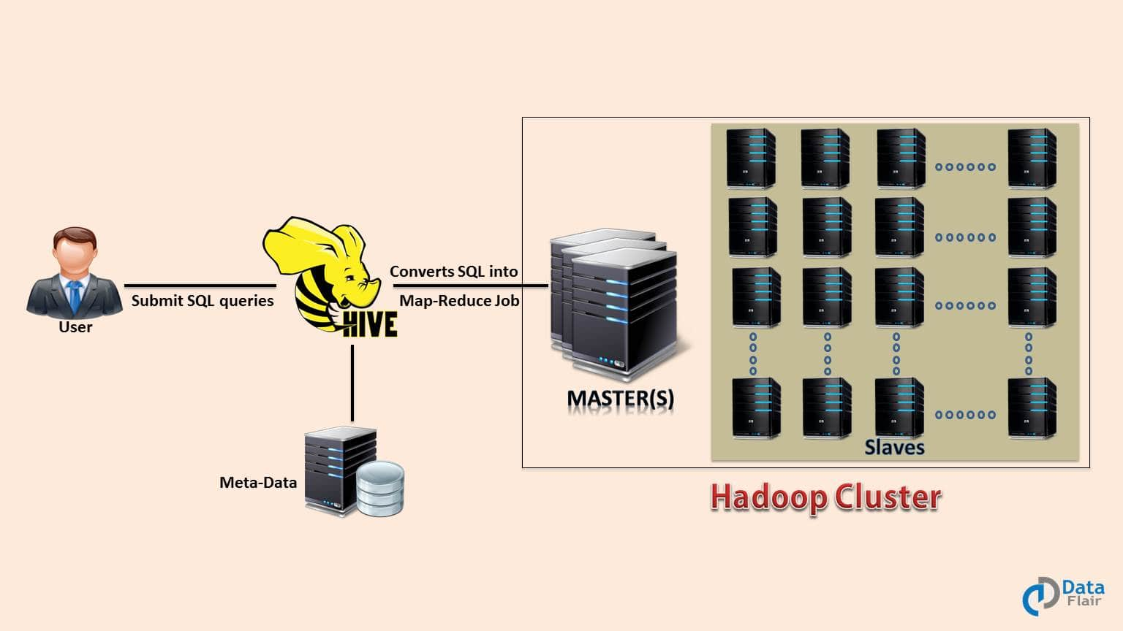
Cont..
HADOOP ECOSYSTEM
HIVE:

Slide 49
Cont..
HADOOP ECOSYSTEM
HIVE:
Hive use language called HiveQL (HQL), which is similar to SQL. HiveQL automatically translates SQL-like queries into MapReduce jobs which will execute on Hadoop.
Main parts of Hive are:
Metastore – It stores the metadata.
Driver – Manage the lifecycle of a HiveQL statement.
Query compiler – Compiles HiveQL into Directed Acyclic Graph(DAG).
Hive server – Provide a thrift interface and JDBC/ODBC server.

Slide 50
Cont..
HADOOP ECOSYSTEM
PIG:
Pig was basically developed by Yahoo which works on a pig Latin language, which is Query based language similar to SQL.
It is a platform for structuring the data flow, processing and analyzing huge data sets.
Pig does the work of executing commands and in the background, all the activities of MapReduce are taken care of. After the processing, pig stores the result in HDFS.
Pig Latin language is specially designed for this framework which runs on Pig Runtime. Just the way Java runs on the JVM.
Pig helps to achieve ease of programming and optimization and hence is a major segment of the Hadoop Ecosystem.

Slide 51
Cont..
HADOOP ECOSYSTEM
Features of PIG:
Extensibility – For carrying out special purpose processing, users can create their own function.
Optimization opportunities – Pig allows the system to optimize automatic execution. This allows the user to pay attention to semantics instead of efficiency
Handles all kinds of data – Pig analyzes both structured as well as unstructured.

Slide 52
Cont..
HADOOP ECOSYSTEM
Hbase:
It’s a NoSQL database which supports all kinds of data and thus capable of handling anything of Hadoop Database. It provides capabilities of Google’s BigTable, thus able to work on Big Data sets effectively.
At times where we need to search or retrieve the occurrences of something small in a huge database, the request must be processed within a short quick span of time. At such times, HBase comes handy as it gives us a tolerant way of storing limited data.

Slide 53
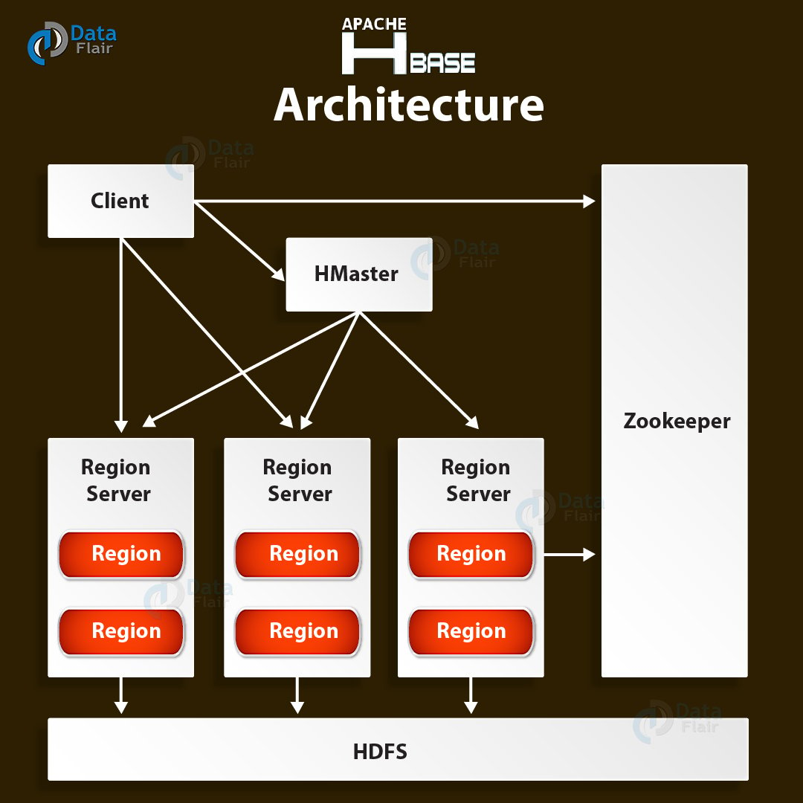
Cont..
HADOOP ECOSYSTEM
Hbase:

Slide 54
Cont..
HADOOP ECOSYSTEM
Hbase:
Two HBase Components namely- HBase Master and RegionServer.
i. HBase Master
It is not part of the actual data storage but negotiates load balancing across all RegionServer.
Maintain and monitor the Hadoop cluster.
Performs administration (interface for creating, updating and deleting tables.)
Controls the failover.
HMaster handles DDL operation.
ii. RegionServer
It is the worker node which handles read, writes, updates and delete requests from clients. Region server process runs on every node in Hadoop cluster. Region server runs on HDFS DateNode.

Slide 55
Cont..
HADOOP ECOSYSTEM
HCatalog:
It is a table and storage management layer for Hadoop.
HCatalog supports different components available in Hadoop ecosystems like MapReduce, Hive, and Pig to easily read and write data from the cluster.
Hcatalog is a key component of Hive that enables the user to store their format and structure.
By default, HCatalog supports RCFile, CSV, JSON, sequenceFile and ORC file formats.

Slide 56
Cont..
HADOOP ECOSYSTEM
Avro:
It is a table and Avro is an open source project that provides data serialization and data exchange services for Hadoop.
These services can be used together or independently.
Big data can exchange programs written in different languages using Avro.

Slide 57
Cont..
HADOOP ECOSYSTEM
Apache Mahout:
Mahout, allows Machine Learnability to a system or application.
Machine Learning, as the name suggests helps the system to develop itself based on some patterns, user/environmental interaction or on the basis of algorithms.
It provides various libraries or functionalities such as collaborative filtering, clustering, and classification which are nothing but concepts of Machine learning.
It allows invoking algorithms as per our need with the help of its own libraries.

Slide 58
Cont..
HADOOP ECOSYSTEM
Apache Mahout:
Once data is stored in Hadoop HDFS, mahout provides the data science tools to automatically find meaningful patterns in those big data sets.
Algorithms of Mahout are:
Clustering – Here it takes the item in particular class and organizes them into naturally occurring groups, such that item belonging to the same group are similar to each other.
Collaborative filtering – It mines user behavior and makes product recommendations (e.g. Amazon recommendations)
Classifications – It learns from existing categorization and then assigns unclassified items to the best category.
Frequent pattern mining – It analyzes items in a group (e.g. items in a shopping cart or terms in query session) and then identifies which items typically appear together.

Slide 59
Cont..
HADOOP ECOSYSTEM
Sqoop:
Sqoop imports data from external sources into related Hadoop ecosystem components like HDFS, Hbase or Hive.
It also exports data from Hadoop to other external sources.
Sqoop works with relational databases such as teradata, Netezza, oracle, MySQL.

Slide 60
Cont..
HADOOP ECOSYSTEM
Apache Flume:
Flume efficiently collects, aggregate and moves a large amount of data from its origin and sending it back to HDFS.
It is fault tolerant and reliable mechanism.
This Hadoop Ecosystem component allows the data flow from the source into Hadoop environment.
It uses a simple extensible data model that allows for the online analytic application.
Using Flume, we can get the data from multiple servers immediately into hadoop.

Slide 61
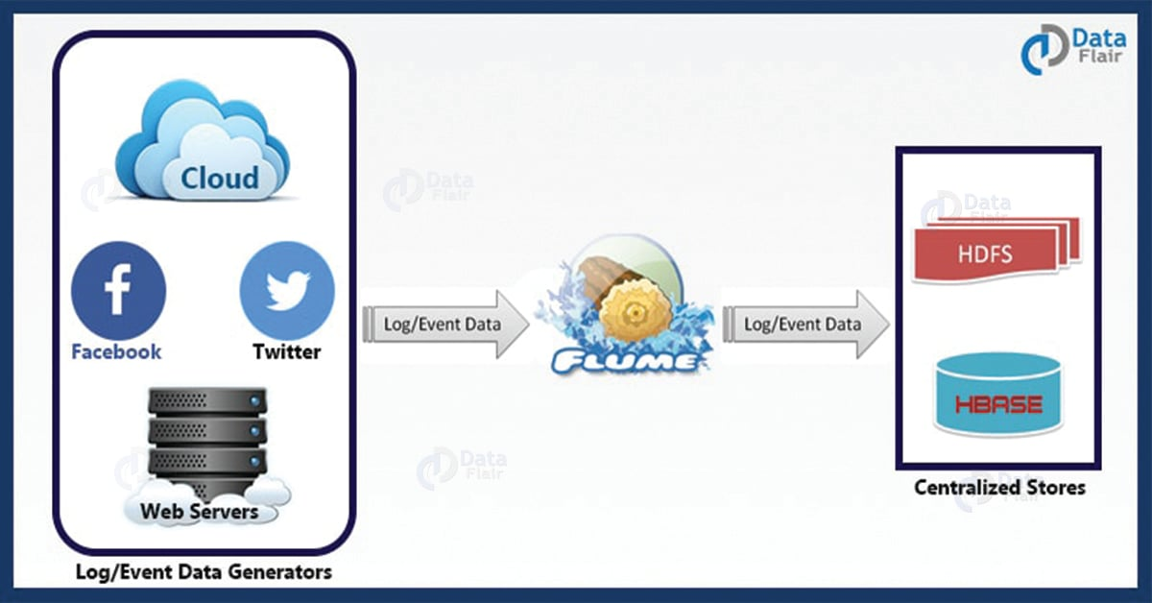
Cont..
HADOOP ECOSYSTEM
Apache Flume:

Slide 62
Cont..
HADOOP ECOSYSTEM
Ambari:
Ambari, another Hadop ecosystem component, is a management platform for provisioning, managing, monitoring and securing apache Hadoop cluster.
Hadoop management gets simpler as Ambari provide consistent, secure platform for operational control.

Slide 63
Cont..
HADOOP ECOSYSTEM
Other Components:
Apart from all of these, there are some other components too that carry out a huge task in order to make Hadoop capable of processing large datasets. They are as follows:
Solr, Lucene: These are the two services that perform the task of searching and indexing with the help of some java libraries, especially Lucene is based on Java which allows spell check mechanism, as well.
Zookeeper: There was a huge issue of management of coordination and synchronization among the resources or the components of Hadoop which resulted in inconsistency, often. Zookeeper overcame all the problems by performing synchronization, inter-component based communication, grouping, and maintenance.

Slide 64
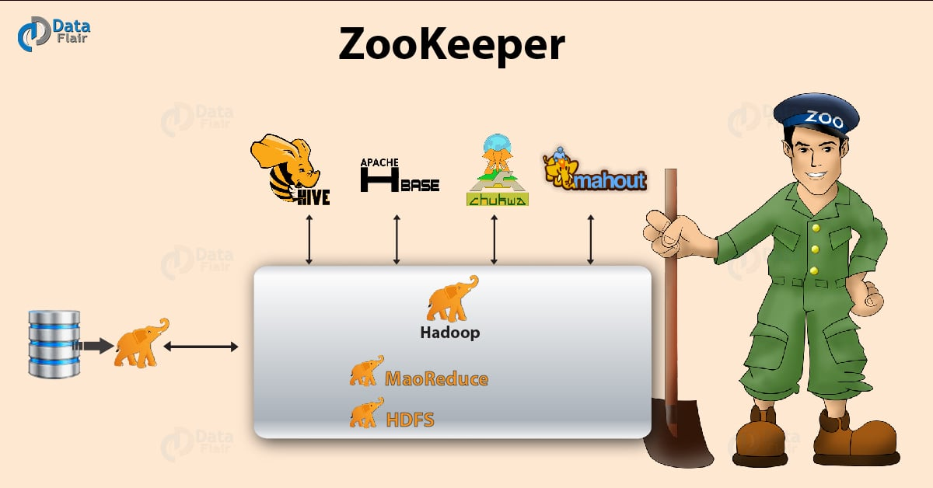
Cont..
HADOOP ECOSYSTEM

Slide 65
Cont..
HADOOP ECOSYSTEM
Apache Spark:
It’s a platform that handles all the process consumptive tasks like batch processing, interactive or iterative real-time processing, graph conversions, and visualization, etc.
It consumes in memory resources hence, thus being faster than the prior in terms of optimization.
Spark is best suited for real-time data whereas Hadoop is best suited for structured data or batch processing, hence both are used in most of the companies interchangeably.

Slide 66
Cont..
HADOOP ECOSYSTEM
Other Components:
Oozie: Oozie simply performs the task of a scheduler, thus scheduling jobs and binding them together as a single unit.
There is two kinds of jobs .i.e Oozie workflow and Oozie coordinator jobs. Oozie workflow is the jobs that need to be executed in a sequentially ordered manner whereas Oozie Coordinator jobs are those that are triggered when some data or external stimulus is given to it.

Slide 67
Cont..
HADOOP ECOSYSTEM
Other Components:
Since the initial release of Hadoop in 2011, many projects have been developed to add incremental functionality to Hadoop and have collectively become known as the Hadoop ecosystem.
Hadoop now comprises more than 100 software projects under the Hadoop umbrella, capable of nearly every element in the data lifecycle, from collection, to storage, to processing, to analysis and visualization.
Each of these individual projects is a unique piece of the overall data management solution.

Slide 68
Cont..
APACHE KAFTKA
Apache Kafka:
Part of processing real-time events, such as those commonly generated by smart objects, is having them ingested into a processing engine.
The process of collecting data from a sensor or log file and preparing it to be processed and analyzed is typically handled by messaging systems.
Messaging systems are designed to accept data, or messages, from where the data is generated and deliver the data to stream-processing engines such as Spark Streaming or Storm.

Slide 69
Cont..
APACHE KAFTKA
Apache Kafka:
Apache Kafka is a distributed publisher-subscriber messaging system that is built to be scalable and fast.
It is composed of message brokers, where producers write data and consumers read data from these brokers.
The data flow from the smart objects (producers), through a topic in Kafka, to the real-time processing engine.

Slide 70
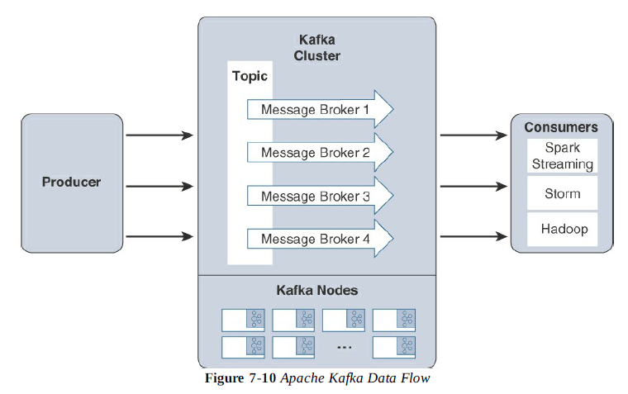
Cont..
APACHE KAFTKA
Apache Kafka:

Slide 71
Cont..
APACHE KAFTKA
Apache Kafka:
Due to the distributed nature of Kafka, it can run in a clustered configuration that can handle many producers and consumers simultaneously and exchanges information between nodes, allowing topics to be distributed over multiple nodes.
The goal of Kafka is to provide a simple way to connect to data sources and allow consumers to connect to that data in the way they would like.

Slide 72
Cont..
APACHE SPARK
Apache Spark:
Apache Spark is an in-memory distributed data analytics platform designed to accelerate processes in the Hadoop ecosystem.
The “in-memory” characteristic of Spark is what enables it to run jobs very quickly.
At each stage of a MapReduce operation, the data is read and written back to the disk, which means latency is introduced through each disk operation.
However, with Spark, the processing of this data is moved into high-speed memory, which has significantly lower latency. This speeds the batch processing jobs and also allows for near-real-time processing of events.

Slide 73
Cont..
APACHE SPARK
Apache Spark:
Real-time processing is done by a component of the Apache Spark project called Spark Streaming.
Spark Streaming is an extension of Spark Core that is responsible for taking live streamed data from a messaging system, like Kafka, and dividing it into smaller micro batches.
These microbatches are called discretized streams, or DStreams.
The Spark processing engine is able to operate on these smaller pieces of data, allowing rapid insights into the data and subsequent actions.
Due to this “instant feedback” capability, Spark is becoming an important component in many IoT deployments.

Slide 74
Cont..
APACHE SPARK
Apache Spark:
Systems that control
safety and security of personnel,
time-sensitive processes in the manufacturing space,
and infrastructure control in traffic management
all benefit from these real-time streaming capabilities.

Slide 75
Cont..
XIVELY CLOUD
Xively Cloud For IoT :
Xively (formerly known as Cosm and Pachube) is an Internet of Things (IoT) platform owned by Google.
Xively offers product companies a way to connect products, manage connected devices and the data they produce, and integrate that data into other sy
A Platform as a Service built for the IoT.
Includes directory services, data services, a trust engine for security, and web-based management application.
Xively's messaging is built on a protocol called MQTT.
The API supports REST, WebSockets and MQTT.

Slide 76
Cont..
XIVELY CLOUD
Xively Cloud For IoT :
Xively is a system for deploying IoT applications on the cloud. It is offered as PaaS.
Xively is basically a data collection, management, and distribution infrastructure.
It also provides APIs to connect and develop IoT applications.
Xively also provides tools to model your connected business.
This capability is highly beneficial to build any IoT based product.

Slide 77
Cont..
XIVELY CLOUD
Xively Cloud For IoT :
Other than that Xively also provides Management as well as operational tools.
Xively can be connected to most of the IoT frameworks and microcontrollers in the market to create a ‘smart’ project or product.
Xively Python Libraries can also be used to embed python code as per the Xively APIs.
A Xively Web interface is provided to be used for easy implementation of front end interface.

Slide 78
Cont..
XIVELY CLOUD
Xively Cloud For IoT :
Xively also comes with multiple language and platform support. We can implement HTTP protocols, APIs, MQTT.
This makes the device connectivity a lot easier with Xively cloud.
All the devices can be connected to Xively Cloud for real-time processing and archiving to cloud.
IOT application developers can write the frontend for IoT applications as per their requirements.
This helps in convenient management of apps with Xively cloud and other APIs.

Slide 79
Cont..
XIVELY CLOUD
Xively Cloud For IoT :
Xively is very popular with companies which deal with IoT based device manufacturing and development.
Companies using Xively can rely on the secure connectivity of devices as well as the seamless data management capability.

Slide 80
Cont..
XIVELY CLOUD
How to use Xively?
Programmers or Developers have to register with Xively to use cloud services.
After registration and account creation, developers can create different devices for which he has to create an IoT app. It can be easily done using the templates provided in the Web Interface of Xively.
Each connected devices is allocated a unique FEED_ID. It specifies the data stream and metadata of the connected device.
Once this is done permissions on the IoT devices are assigned using the available APIs. The available permissions are Create, Update, Delete and Read.
One or more bidirectional channels are created after we connect a device with Xively. Each channel is unique to the device connected.
Xively cloud is connected with the help of these channels.
Xively APIs are used by IoT devices to create communication enabled products.

Slide 81
Cont..
EDGE STREAMING ANALYTICS
Programmers or Edge streaming analytics in IoT (Internet of Things) refers to the process of analyzing data from IoT devices at or near the location where the data is generated, instead of sending all the data to centralized cloud servers for processing.
This approach provides real-time insights, reduces latency, and minimizes bandwidth usage by processing and filtering data locally on edge devices (such as sensors, gateways, or edge servers) before transmitting only relevant or aggregated data to the cloud.

Slide 82
Cont..
EDGE STREAMING ANALYTICS
Here are some key aspects and benefits of edge streaming analytics in IoT:
1.Real-time Insights: By analyzing data locally at the edge, you can make instant decisions without waiting for data to travel to a distant cloud server. This is especially crucial for applications that require immediate action, such as industrial automation, autonomous vehicles, or healthcare monitoring.
2.Reduced Latency: Data doesn’t need to travel far, leading to significantly reduced latency. This is important for time-sensitive applications that need to respond quickly to changing conditions.
3.Bandwidth Optimization: Sending only the most relevant or pre-processed data to the cloud reduces the volume of data transmitted. This is particularly valuable in environments with limited or costly network bandwidth, such as remote locations or devices with limited connectivity.

Slide 83
Cont..
EDGE STREAMING ANALYTICS
Here are some key aspects and benefits of edge streaming analytics in IoT:
4.Improved Security and Privacy: By processing data locally, sensitive information can be kept on-site, reducing the risk of exposure or breaches during transmission to the cloud. It also gives more control over data access and privacy policies.
5.Scalability: With the increasing number of IoT devices, edge analytics allows for distributed processing, reducing the load on central servers and improving the scalability of the system.
6.Autonomy: Edge devices can continue functioning even if the network connection to the cloud is intermittent or lost. They can continue to process and act on data autonomously, ensuring continuous operation.

Slide 84
Cont..
EDGE STREAMING ANALYTICS
Use Cases of Edge Streaming Analytics in IoT:
Smart Cities: Real-time traffic monitoring, waste management, and air quality monitoring.
Manufacturing: Predictive maintenance, quality control, and real-time monitoring of equipment performance.
Healthcare: Remote patient monitoring, real-time diagnostics, and personalized healthcare.
Agriculture: Precision farming, monitoring of soil conditions, and crop health in real-time.
Energy Management: Smart grids, real-time energy consumption monitoring, and optimization.

Slide 85
Cont..
PYTHON WEB APPLICATION
Python web application for IoT is a great way to manage, visualize, and interact with IoT devices and the data they generate.
Python is a popular choice for IoT applications due to its simplicity, large number of libraries, and community support.
A Python-based web app can provide a dashboard to monitor real-time data, control devices, and perform analytics.

Slide 86
Cont..
PYTHON WEB APPLICATION
1.Set up IoT Devices and Data Collection:
IoT Devices: IoT devices (sensors, actuators, etc.) collect data such as temperature, humidity, motion, or other environmental conditions. These devices often communicate through protocols like MQTT, HTTP, or CoAP.
Data Collection: You’ll need a mechanism to gather data from these devices, either by sending data to a central server, cloud service, or edge device for processing.
2.Backend Development with Flask or Django:
Flask: Flask is a lightweight web framework for Python that’s great for building simple web applications or APIs. It’s well-suited for IoT projects where you might want to build an API for data collection, control, and visualization.
You can set up endpoints to receive data from IoT devices (via HTTP POST or MQTT messages) and store the data in a database.

Slide 87
Cont..
PYTHON WEB APPLICATION
Django: Django is a more full-featured web framework, ideal if you need more advanced features like user authentication, admin panels, or complex database interactions.
Django can also handle real-time data streams, though you may need additional tools like Channels or Celery for background tasks.
3.Database for storing IoT data:
You will need a database to store and manage the IoT data. Options include:
Relational Databases (SQL): MySQL, PostgreSQL (great for structured data like sensor readings with timestamps).
NoSQL Databases: MongoDB (if the data is semi-structured, like sensor logs), or InfluxDB (specifically designed for time-series data).

Slide 88
Cont..
PYTHON WEB APPLICATION
3.Database for storing IoT data:
SQLAlchemy is a common ORM (Object Relational Mapper) used with Flask and Django to simplify database interaction.
4. Frontend with HTML, CSS, and JavaScript:
The frontend allows users to interact with the data and devices.
HTML/CSS: Used for creating the structure and style of your web pages.
JavaScript: To make the web app interactive, you can use JavaScript libraries like D3.js or Chart.js to visualize IoT data (e.g., graphs, real-time updates).
If you need a more dynamic UI, consider using React or Vue.js for the frontend.

Slide 89
Cont..
PYTHON WEB APPLICATION
5.Real-time Data and WebSockets:
For real-time data streaming (such as receiving sensor data or controlling IoT devices in real time), you can use WebSockets.
Flask-SocketIO or Django Channels can be used to manage real-time communication between the server and client.
WebSockets allow for bidirectional communication, so your web app can push updates to the frontend as soon as new data comes in from IoT devices.
6. Integration with IoT Protocols (e.g., MQTT):
IoT devices often communicate using protocols like MQTT, a lightweight messaging protocol for small sensors and mobile devices optimized for low-bandwidth, high-latency, or unreliable networks.

Slide 90
Cont..
PYTHON WEB APPLICATION
6. Integration with IoT Protocols (e.g., MQTT):
Paho MQTT is a popular Python library for MQTT. Your Python backend can subscribe to MQTT topics (e.g., temperature readings) and push updates to the web frontend via WebSockets.
7. Authentication and Authorization:
If you want to control access to your IoT web application, you can implement user authentication using Flask-Login (for Flask) or Django’s built-in authentication system.
This ensures that only authorized users can access specific data or control IoT devices.

Slide 91
Cont..
PYTHON WEB APPLICATION
7. Authentication and Authorization:
Flask serves as the web framework.
SocketIO allows real-time communication between the server and the client (browser).
Paho MQTT subscribes to the MQTT broker to receive sensor data and pushes it to the client in real-time using WebSockets.
The client (browser) listens for updates and displays them dynamically.

Slide 92
Cont..
PYTHON WEB APPLICATION
8.Deployment:
You can deploy this web application to platforms like Heroku, AWS, Google Cloud, or Azure.
If you want to host the application locally for a small setup, you can run it on a Raspberry Pi or similar edge device that collects and processes IoT data.

